Slide 1
INVENTORY MANAGEMENT SYSTEM
Submitted T0: Sir Hamza Imran
Submitted by: Muhammad Muneeb,Muddasir Mustafa
BSAI-2A
Reg# 22108190,22108251

Slide 2
What is inventory management system?
Inventory is the goods or materials a business intends to sell to customers for profit. Inventory management, a critical element of the supply chain, is the tracking of inventory from manufacturers to warehouses and from these facilities to a point of sale.

Slide 3
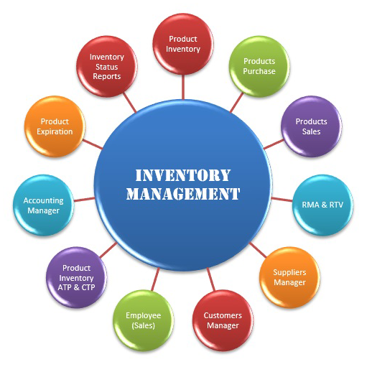

Slide 4
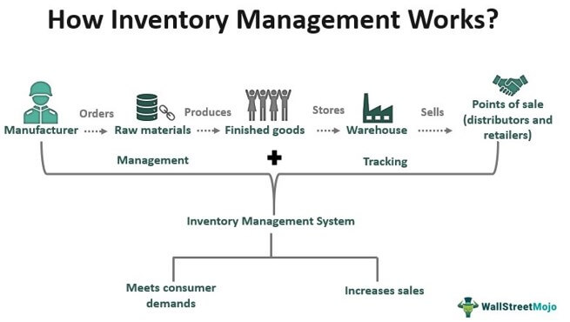

Slide 5
How does inventory management work?
Purchasing inventory: Ready-to-sell goods are purchased and delivered to the warehouse or directly to the point of sale.
Storing inventory: Inventory is stored until needed. Goods or materials are transferred across your fulfillment network until ready for shipment.
Profiting from inventory: The amount of product for sale is controlled. Finished goods are pulled to fulfill orders. Products are shipped to customers.

Slide 6
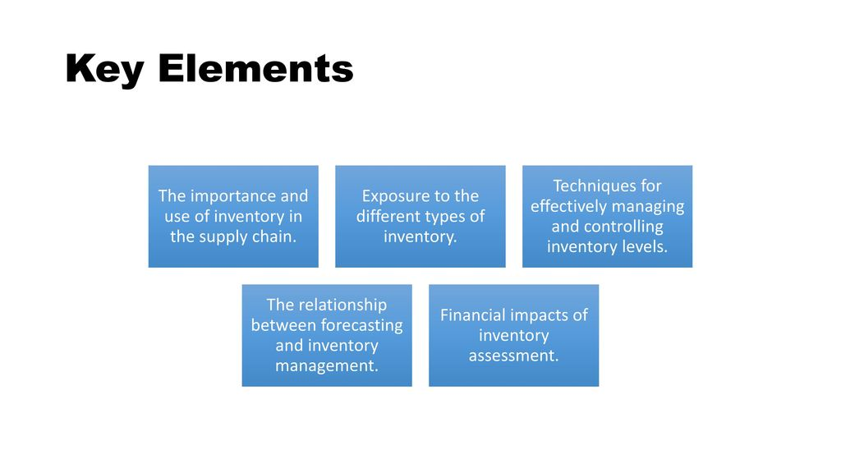

Slide 7
Why is inventory management important?
Inventory can be a company’s most important asset. Inventory management is where all the elements of the supply chain converge. Too little inventory when and where it's needed can create unhappy customers.

Slide 8
The future of inventory management
Globalization, technology and empowered consumers are changing the way businesses manage inventory. Supply chain operators will use technologies that provide significant insights into how supply chain performance can be improved.

Slide 9
Future trends
Smart Shelves
A smart inventory system provides means to automate manual tasks such as item tracking and counting, inventory database updating, report generation, restocking, etc.,
Blockchain for Supply Chain Transparency
Blockchain technology can provide real-time visibility and tracking of goods and products throughout the entire supply chain, from production to distribution to end consumers.

Slide 10
Code Explanation :-
Include the necessary header files: <iostream> for input-output operations and <string> for using the string data type.
Use the standard namespace. It allows you to use classes and functions in the std namespace without qualifying them with std::.
Define a class named InventoryManager.
Public Section: - Declare a constructor, destructor, and a public method run ().
Private Section: - Define a nested private struct named Item with three fields
Declare a pointer named inventory for dynamic allocation of an array of Item objects, and an integer size to keep track of the number of items
Constructor: - Initialize inventory pointer to nullptr and size to 0.
Destructor: - Free the dynamically allocated memory if inventory is not null.
Contains the main loop for running the inventory system.
Display the menu options.
Adds a new item to the inventory.
Displays all items in the inventory.
Deletes an item from the inventory based on its name.
Creates an object of InventoryManager and runs the system.

Slide 11


